Slide 1
IMPLEMENTING A ONEM2M BASED IOT PLATFORM
A Project Presentation on
By
DIKSHIT GAUTAM
2018A8PS0816
SUNIL SAHARAN
2018B3A30957P

Slide 2
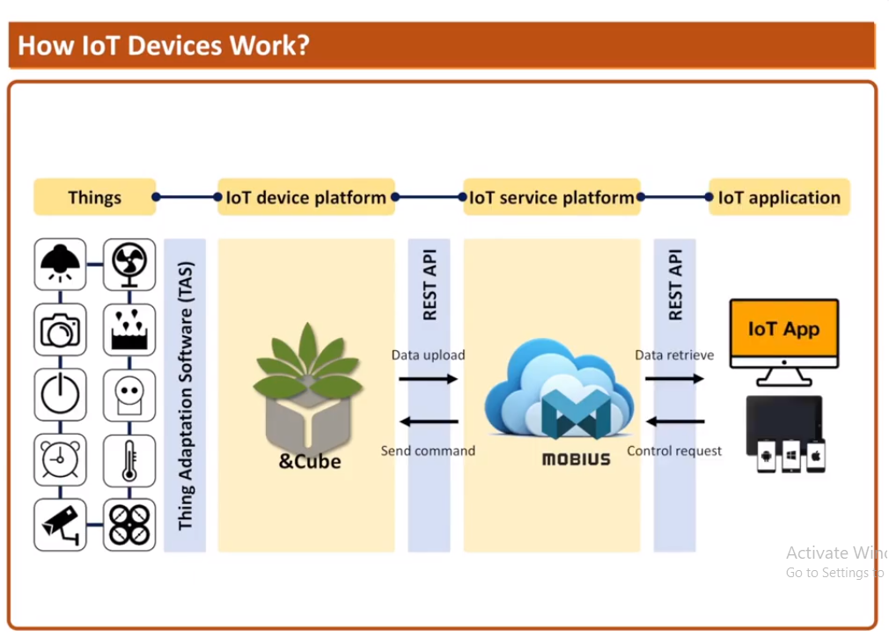
INTRODUCTION:
The task of IOT device management has always been challenging due to heterogeneity of things in terms of communication, types of data generated, access control for clients, accessing and erasing information, etc. To solve these kind of issues and interoperate with other Machine to Machine systems, the “oneM2M global initiative” was established.

Slide 3
INTRODUCTION:
OneM2M’s aim is to develop standards and specifications to enable the machine to machine communications market to fully develop and take off. The oneM2M aims to achieve to develop standards to support machine to machine communication Service provider, application developers, and device manufacturers to help develop a larger market and ecosystem for their products and so grow the one M2M market.
Our objective is to deploy a server based on oneM2M standards which can be used by application developers as a middleware to connect with lower level devices, sensors, actuators and exchange data with those devices.

Slide 4
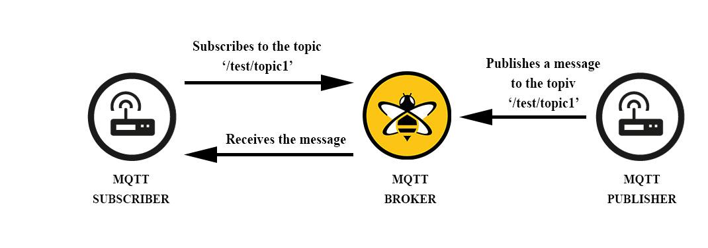
MQTT
(Message Queue Telemetry Transport) is a lightweight network protocol which is used by devices to communicate with each other. It was developed by Dr. Andy Stanford-Clark and Dr. Arlen Nipper in 1999.

Slide 5
MQTT
This protocol is based on a publish-subscribe architecture in comparison to HTTP which uses a request-response architecture. It is a low power consuming protocol and that’s why it is suitable for machine to machine communication in IoT systems

Slide 6
METHODOLOGY:
In this project we are using HC-SR04 Ultrasonic sensor to test the server. This sensor will send the distance data to the IoT server and we can access the data by REST APIs through HTTP for further processing. We are also using <servo motor> as an actuator to test the server.
We have deployed a Mobius server as a CSE on an Ubuntu machine. Eclipse mosquitto has been used as an MQTT broker. We have deployed &Cube Thyme on raspberry pi 3 as an AE. Various tools and resource tree structure used for the project are as follows:

Slide 7
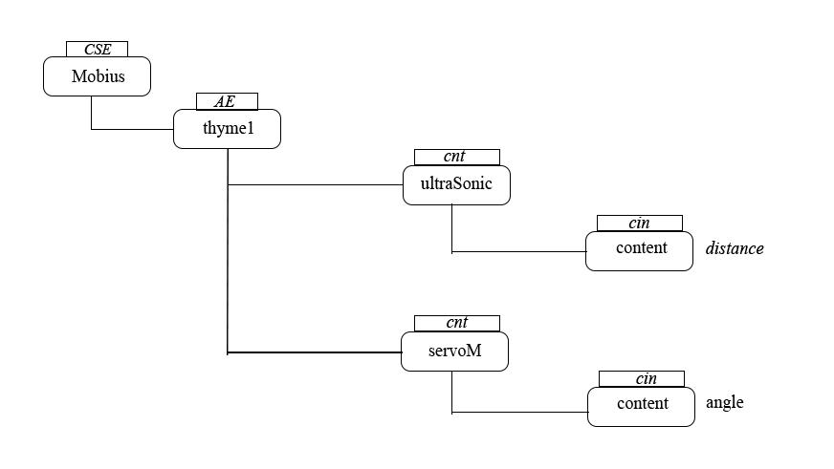
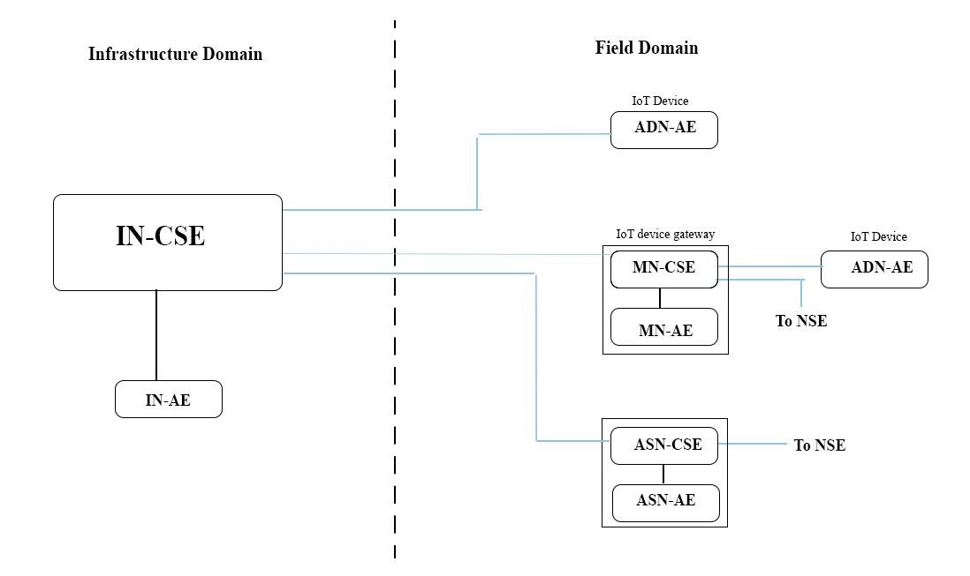
METHODOLOGY :

Slide 8
MOBIUS SERVER :
Mobius server version 2.4.36 has been used. MySQL version 5.7.29 is used for storing and handling data. Mosquitto MQTT broker version 1.6.9 has been used for MQTT communication between the CSE and AE. It's CSE name and CSE ID are ‘Mobius’ and ‘/Mobius2’ respectively by default. OCEAN has provided a suite of REST APIs for accessing and modifying the Mobius server data such as creating or deleting its resources, viewing and deleting the data sent from sensors, giving control commands to the actuators. These APIs can easily be tested using the Postman platform.

Slide 9
&CUBE THYME
&Cube Thyme version 2.0.0 has been used and it has been deployed on raspberry pi. It is used as an IoT device gateway which connects IoT devices to the IoT server, i.e., Mobius server. Thyme communicates with Mobius server through mosquitto broker running on port 1883 of Mobius server. It sends the serialized data to Mobius for sending requests or responses.

Slide 10
TAS(THINGS ADAPTATION SOFTWARE)
TAS is a small middleware program. The TAS program takes the sensor data, converts it into oneM2M defined format and then sends it to Thyme server running on port 3105 for further routing. It can also take actuation commands from the Thyme and convert them into the actuator accepted format. In this project we have developed two TASs, one for controlling servo motor and the other for sending ultrasonic sensor data to thyme.

Slide 11
OUTCOMES :
We were able to control the servo motor from the IoT server .
We were also able to successfully receive distance data from sensor.

Slide 12
FURTHER IMPLEMENTATION :
These two examples of an actuator and a sensor can be used as an example to design other IoT systems which use some other sensors and actuators. Only the TAS programs have to be modified for those cases.

Slide 13
THANK YOU !!

